Slide 1

Note: The data and information in this document is reflective of a hypothetical situation and client. This document is to be used for KPMG Virtual Internship purposes only.
Sprocket Central Pty Ltd
Data analytics approach
[Neema MV – Data Analytics Specialist]

Slide 2
Note: The data and information in this document is reflective of a hypothetical situation and client. This document is to be used for KPMG Virtual Internship purposes only.
Agenda
Introduction
Data Exploration
Model Development
Interpretation

Slide 3
Note: The data and information in this document is reflective of a hypothetical situation and client. This document is to be used for KPMG Virtual Internship purposes only.
Introduction
Place headline insight or information here. This should be the most important point for this slide.
Place any information about this point here.
Place any supporting images, graphs, data or extra text here.

Slide 4
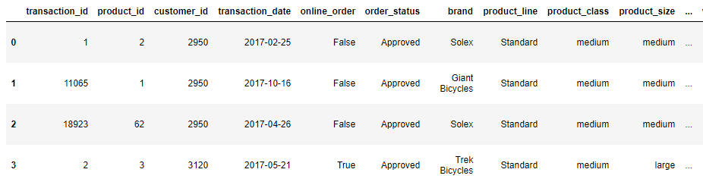
Note: The data and information in this document is reflective of a hypothetical situation and client. This document is to be used for KPMG Virtual Internship purposes only.
Data Exploration
For the Data Exploration, we cleaned the data and grouped the data according to the age, gender and below are our analysis
Below are the exploration methods used for the analysis:
Unique value counts of customer within transaction
Created age bin from DOB
Removed null of 197 nulls from brand, product class, product size
Converted Transaction date to datetime object and other relevant variables as categorical eg. Gender
Place any supporting images, graphs, data or extra text here.

Slide 5
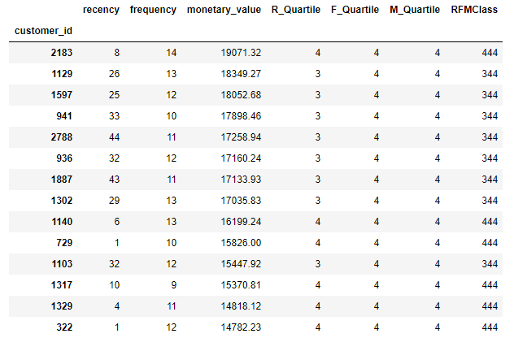
Note: The data and information in this document is reflective of a hypothetical situation and client. This document is to be used for KPMG Virtual Internship purposes only.
Model Development
We went on to build a RFM Analysis model that segments customers based on Recency, Frequency, Monetary Value
Recency is measured from the latest transaction date
We have grouped the buckets from the top best customer to fairly performing customers
The string values used for selection are from ‘444’ to ‘212’
Selected the best from the monetary value in descending order
Place any supporting images, graphs, data or extra text here.

Slide 6
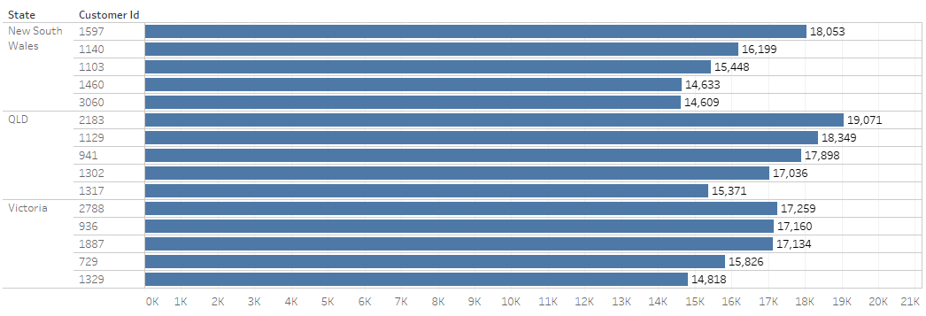
Note: The data and information in this document is reflective of a hypothetical situation and client. This document is to be used for KPMG Virtual Internship purposes only.
Interpretation
The top 1000 customer list is generated using the RFM Analysis
Top 1000 customers are segmented across to monetary value to this store:
Age group : 40 to 50 age
Maximum purchasers are from New South Wales
Gender: Female seems to spend more
Order status: Majority are approved orders
Wealth Management: High value from ‘Mass Customers’
Product Class: Many medium product class are purchased
Place any supporting images, graphs, data or extra text here.

Slide 7
Note: The data and information in this document is reflective of a hypothetical situation and client. This document is to be used for KPMG Virtual Internship purposes only.
Appendix

Slide 8

Note: The data and information in this document is reflective of a hypothetical situation and client. This document is to be used for KPMG Virtual Internship purposes only.
Appendix
We have listed the top 3 customers that provide immense value to the store and the result supports our analysis

